Slide 1
Invisibility Cloak
Team Members
Sri sivathandavan G 3122215002308
Vasanth raj 3122215002309
Vedha Shree3122215002310
Vishwaa D A 3122215002311

Slide 2
Problem Statement
Design and implement a Python program that simulates an "invisibility cloak" effect using computer vision techniques. The program should be able to capture video from a webcam, identify a object(e.g., a person), and replace that objectwith the background, creating the illusion of an invisibility cloak.

Slide 3
Motivation
The motivation behind this project is to revolutionize the film industry by creating a real-time invisibility cloak effect, streamlining the challenging green-screening process.
The goal is to provide filmmakers with a powerful tool that simplifies and accelerates the creation of captivating visual effects, ultimately saving them valuable time and resources.

Slide 4
Objectives
1. AI-Enhanced Health Hazard Prediction
2. Informed Decision-Making
3. User-Centric Design
4. Data Security and Privacy
5. Comprehensive Health Management
6. Integration and Scalability
7. Real-Time Feedback
8. Education and Awareness
9. Continuous Improvement

Slide 5
Methodology
Agile: In navigating this project with an Agile mindset, our development process will involve continuous iterations, fostering collaboration among diverse teams, and maintaining adaptability to respond effectively to evolving healthcare requirements and user needs.
Algorithm Used - Morphological Operations (Opening and Dilation), YOLO:
Morphological operations are used to clean up the mask. Opening operation helps to remove noise from the mask, and dilation is used to fill in gaps in the mask.
Yolo model has been integrated with opencv to create cloak effect in the cv2 window itself.

Slide 6
Innovative Ideas
This project focuses on not only predicting heart disease but also recommends on when to visit the doctor.
It uses Bayesian belief system for the prediction which is highly accurate.
The probabilities are taken from already existing dataset which increases the accuracy.
Machine Learning concepts are used to show the worsening of the health of the heart and predict the heart disease.

Slide 7
Requirements and Specifications
Functional Requirements
1. User Registration: The system must allow new users to register by providing valid information (name, email, password) and ensure secure verification and login.
2. User Authentication: The system must verify login credentials for registered users, granting access upon successful validation and providing a password reset option for incorrect entries.
3. User Profile Management: Users should be able to manage and update their profiles with essential information, ensuring accurate and complete data storage.

Slide 8
4. Real-Time Video Processing: The program must be capable of processing live video from a webcam in real-time.
5. Color Selection: The user should have the ability to interactively select a color (e.g., red, green, etc.) to serve as the invisibility cloak.
6. Background Capture: Provide functionality to capture and save a background image that will be used for the invisibility effect.
7. Segmentation: Segmenting out the captured color
8. Background Replacement: Replace the pixels corresponding to the selected color with the corresponding pixels from the captured background image.

Slide 9
Non-Functional Requirements:
Security
Scalability
Concurrent User Support
Data Retrieval Efficiency
Algorithm Processing Time
Reliability

Slide 10
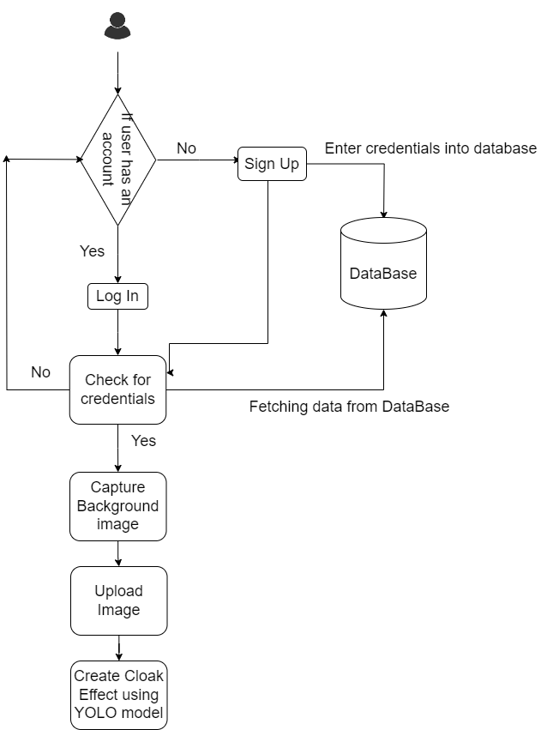
BlockDiagram:

Slide 11
YOLO Algorithm:
Implementing the "You Only Look Once" (YOLO) object detection model with OpenCV in Python,
The invisibility cloak application uses real-time video input.
The program captures video frames, identifies a specified object, and replaces it with the background, effectively creating an illusion of invisibility.
Continuously update the mask to ensure real-time invisibility as the user moves.

Slide 12




Tools
Python
HTML
CSS
JavaScript
Flask

Slide 13
References
https://medium.com/programming-fever/invisibility-cloak-using-opencv-cf2d7d889
https://learnopencv.com/invisibility-cloak-using-color-detection-and-segmentation-with-opencv/
https://ieeexplore.ieee.org/document/9772883

